Slide 1
Genome Annotation
Alexey V. Zimin
BME580.417(707)

Slide 2
Genome annotation
Protein coding gene annotation solves two main problems:
  Locate transcripts
  Locate protein coding regions (Open Reading Frames, or CoDing Sequences) within transcripts
Other kinds of annotations:
  Long non-coding RNA annotations
  Repeat annotation
  Short RNA annotations (tRNA, miRNA, etc)

Slide 3
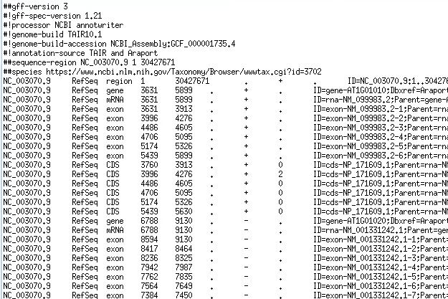
Protein coding and lncRNA annotation
Protein coding and lncRNA annotation locates on the genome the coordinates of:
  genes
  transcripts
  protein coding sequences
Usually reported in GFF3 or GTF format

Slide 4
Gene structure on the genome
Genome
gene
exon
exon
Genome
exon
exon
CDS
3’ UTR
Genome
5’ UTR
CDS
CDS
CDS
Genome
exon
exon
exon
exon
exon
CDS
3’ UTR
Genome
5’ UTR
5’ UTR
5’UTR
CDS
CDS
Start codon (ATG)
Stop codon (TAA,TAG,TGA)

Slide 5
Gene structure in transcript(spliced) coords
gene
transcript or mRNA
exon
exon
exon
exon
exon
5’ UTR
5’ UTR
5’UTR
CDS
CDS
CDS
3’ UTR
transcript or mRNA
exon
exon
exon
exon
5’ UTR
CDS
CDS
CDS
CDS
3’ UTR

Slide 6
GFF/GTF files provide a map for all known genome features
Column | Description
Seqname | Name of chromosome, scaffold or contig
Source | Name of the datasource
Feature | Feature type (e.g. gene, exon, transcript, CDS, five_prime_UTR)
Start | Start position of the feature
End | End position of the feature
Empty | ‘.’
Strand | Defined as + (forward) or - (reverse)
Frame | Either ‘0’, ‘1’, or ‘2’ - indicating reading frame by base position
Attribute | A semicolon separated list of other info about the feature
GFF has many versions, but the two most popular are:
GTF2 (Gene Transfer Format): https://mblab.wustl.edu/GTF2.html
GFF3 (Generic Feature Format): https://github.com/The-Sequence-Ontology/Specifications/blob/master/gff3.md

Slide 7
Locating transcripts on the genome
Two ways to find protein coding and long non-coding RNA transcripts on the genome:
  Align RNA-seq data(HISAT,STAR) + assemble(StringTie)
  Ab initio (AUGUSTUS, SNAP, GeneMark)
    Only for protein coding transcripts, only find CDS (CoDing Sequence)
Other RNA annotations:
  Repeat annotation (RepeatFinder)
  Short RNA annotations (tRNA, miRNA, etc) -- (tRNAScan, Infernal)

Slide 8
Challenges in annotation
Alternative isoforms:
  Identifying all of them from the data can be algorithmically challenging
  Not all isoforms are expressed in all tissues under all conditions, which requires many RNA-seq experiments to produce comprehensive annotation
Coding vs. non-coding, and if coding where is the CDS:
  How do we tell which assembled transcripts are coding for functional proteins?
  Typically one can find several different ORFs in different frames on a transcript -- which frame is the right one?

Slide 9
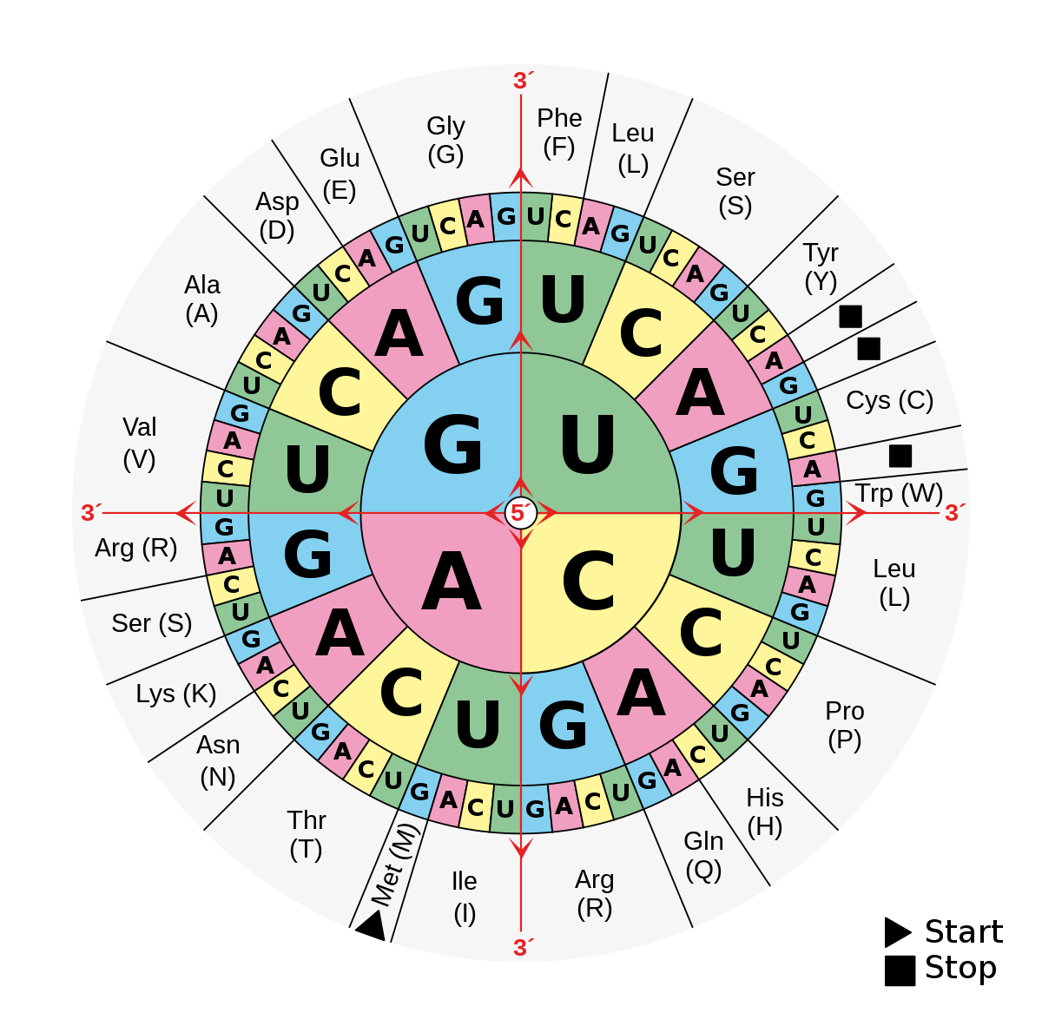
Recall amino-acid translation table

Slide 10
Where is the ORF?
Finding the ORF requires:
  Identifying the frame (out of 3 if strand is known)
  Identifying start
  The two conditions above specify the stop
  Sequence: AACATGGGATGGAATAATTCGTGAAG
  Frame 0: AAC ATG GGA TGG AAT AAT TCG TGA AG
  Protein: M G W N N S *
  Frame 1: AA CAT GGG ATG GAA TAA TTC GTG AAG
  Protein: M E *

Slide 11
How do we find the right ORF?
ORF finder software -- TransDecoder, input spliced transcripts, output ORFs
  Makes mistakes in cases when there are two ORFs of comparable length in two different frames
  Will find ORFs in non-coding transcripts
Ab initio gene finders -- AUGUSTUS, GeneMark, SNAP
  Work on unspliced DNA
  Many false positives
  CDSs they find may not be intron-chain compatible with transcripts -- which one is correct?

Slide 12
How do we find the right ORF?
Protein homology:
  Proteins are conserved over large evolutionary distances
Proteins can be aligned to the DNA:
  Alignments must be done in Amino Acid space because
  DNA->Protein is unique, but Protein->DNA is not
  Translate genome to AA in six frames (three forward and three reverse) and then align AA sequences
  Can use Smith-Waterman, minimizers, suffix arrays
  Once AA are aligned, can go back to DNA coordinates
Protein alignment can provide the ORF and can tell which transcripts are protein coding

Slide 13
What is an annotation pipeline
Annotation pipeline is a software product that employs a collection of programs that locate functional elements on the genome
Input: Genome, RNA-seq data, Protein sequences from related species
Output: Gene annotation in GFF/GTF format

Slide 14
Eukaryotic annotation pipelines
Evidence-based (alignments of transcripts and proteins):
  EviAnn by Zimin et al.
Ab initio-based
  BRAKER3 by Borodovsky et al.
Mix of evidence and ab initio:
  MAKER{2,3} by Yandell et al.
  EGAPx by NCBI

Slide 15
Basic design of EviAnn
Transcripts built from RNA-seq and other data (HISAT2+StringTie2)
Compare intron chains
genome
transcript
CDS alignment
CDSs from alignment of proteins from several related species (miniprot)
Transcript and (partially) matching CDS
No matching CDS
No matching transcript
Annotate protein coding, train Weight Array Matrix (WAM) for splice sites
Screen splice sites
2nd order WAM
2nd order WAM
Screen splice sites
Look for an ORF, annotate if found, or annotate as lncRNA
Combine, filter, then annotate CDS only
Combine results, detect pseudogenes, output annotation

Slide 16
Test data sets
A. thaliana, D. melanogaster:
  5-6 RNA-seq experiments
  Proteins from 5-10 close relatives
Compare EviAnn, BRAKER3, MAKER2+SNAP, EGAPx
  EviAnn, BRAKER3 and EGAPx: aligned BAM files + proteins
  MAKER2: transcript assemblies by StringTie2 as evidence + proteins

Slide 17
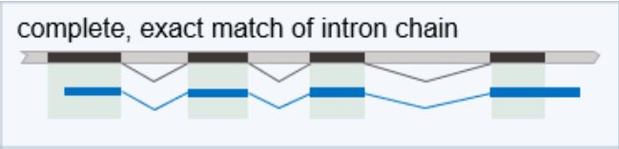
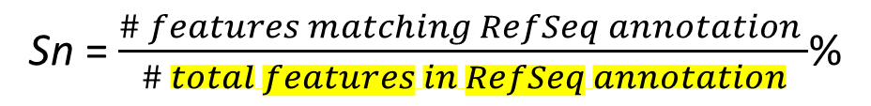
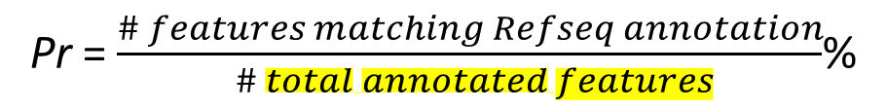
Evaluations
gffcompare to RefSeq annotations of:
-- protein coding genes
-- long non-coding RNA’s
Sn = $\frac{\# features matching RefSeq annotation }{\# total features in RefSeq annotation}$%
Pr = $\frac{\# features matching Refseq annotation}{ \# total annotated features}$%
Evaluate quality of transcripts, gene loci and proteins

Slide 18
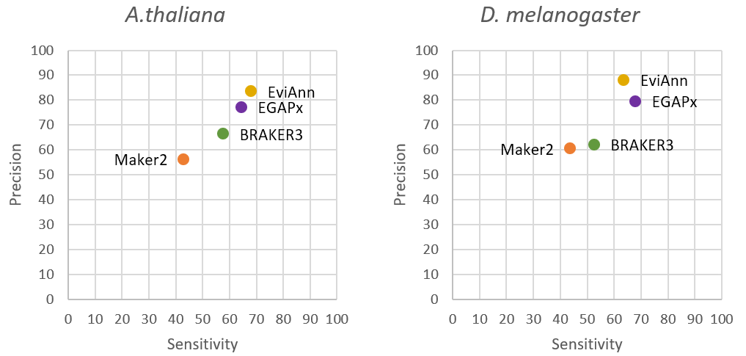
Evaluation of genes (gene loci)
A gene or gene locus counts as annotated correctly if a transcript or a CDS match the reference at the locus

Slide 19
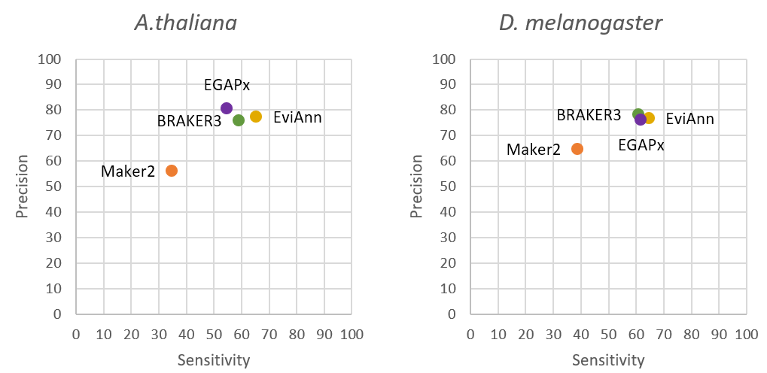
Evaluation of proteins
A protein is correctly annotated if CDS matches exactly to a reference protein.

Slide 20
EviAnn timings (24-core Intel Xeon Gold)
Wall-clock time in hours, excluding the time spent on alignment of RNA-seq data.
 | A.thaliana | D.melanogaster
EviAnn | 0.3 | 0.3
BRAKER3 | 13.2 | 7.3
EGAPx | 6.8 | 8.4
MAKER2 | 168 | 34

Slide 21
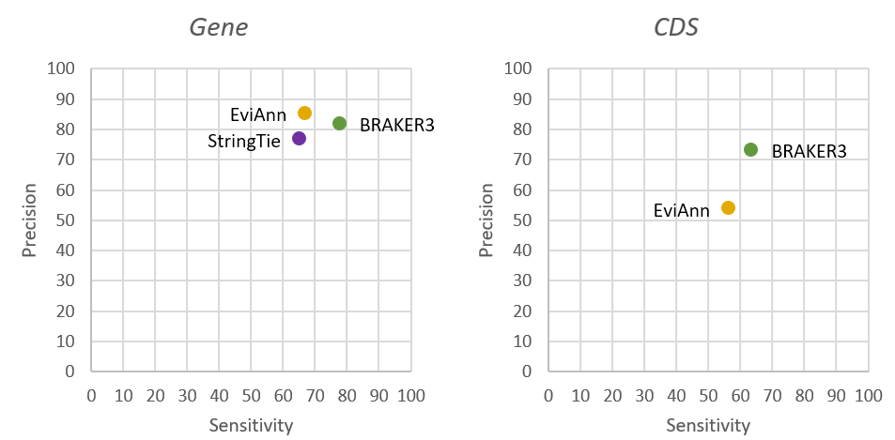
EviAnn Shortcomings
No proteins from close relatives (neighboring taxonomic Tribe of Family) available -- BRAKER3 will work better, e.g. A.thaliana order removed:

Slide 22
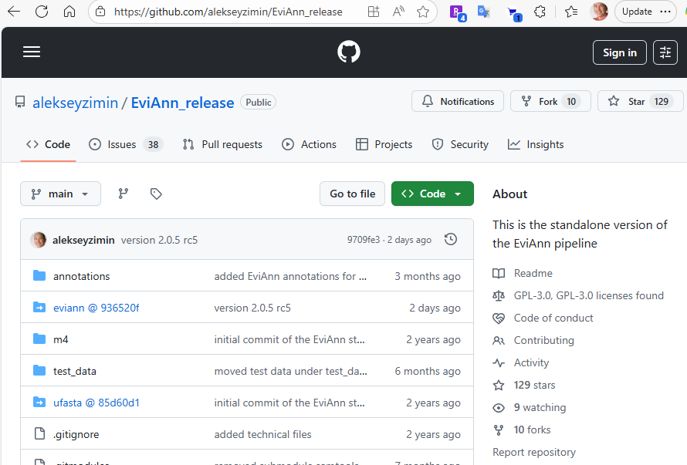
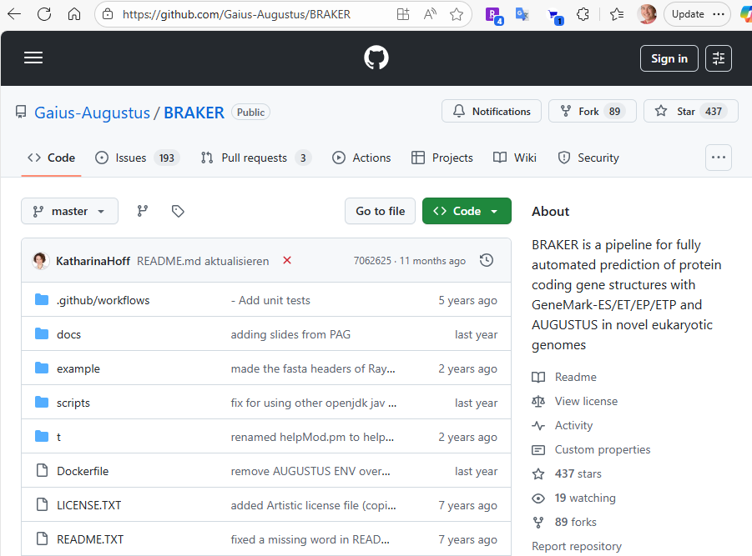
Obtaining EviAnn and BRAKER3
Both programs available from Bioconda:
  conda install eviann
  conda install braker3
Or from github:

Slide 23
Summary: how to annotate a eukaryotic genome
Sequence >5 RNA-seq datasets from different tissues
Check NCBI taxonomy for related species’ proteins:
  Search for species in NCBI Taxonomy
  Use EviAnn if >~ 400K proteins are available from species of neighboring Tribe or Family
  Use BRAKER3 if ~< 400K proteins are available from species of neighboring Tribe or Family
Or you can use both:
  Run BRAKER3, then run EviAnn inputting BRAKER3 annotation with -c

